Slide 1


Slide 2
Lukas Wallrich (lukas.wallrich@ stmarys.ac.uk) October 2020 .
PSY4013 – Intro to Social Psychology
5: Challenges to Social Psychology
A: Critiques of the quantitative approach

Slide 3
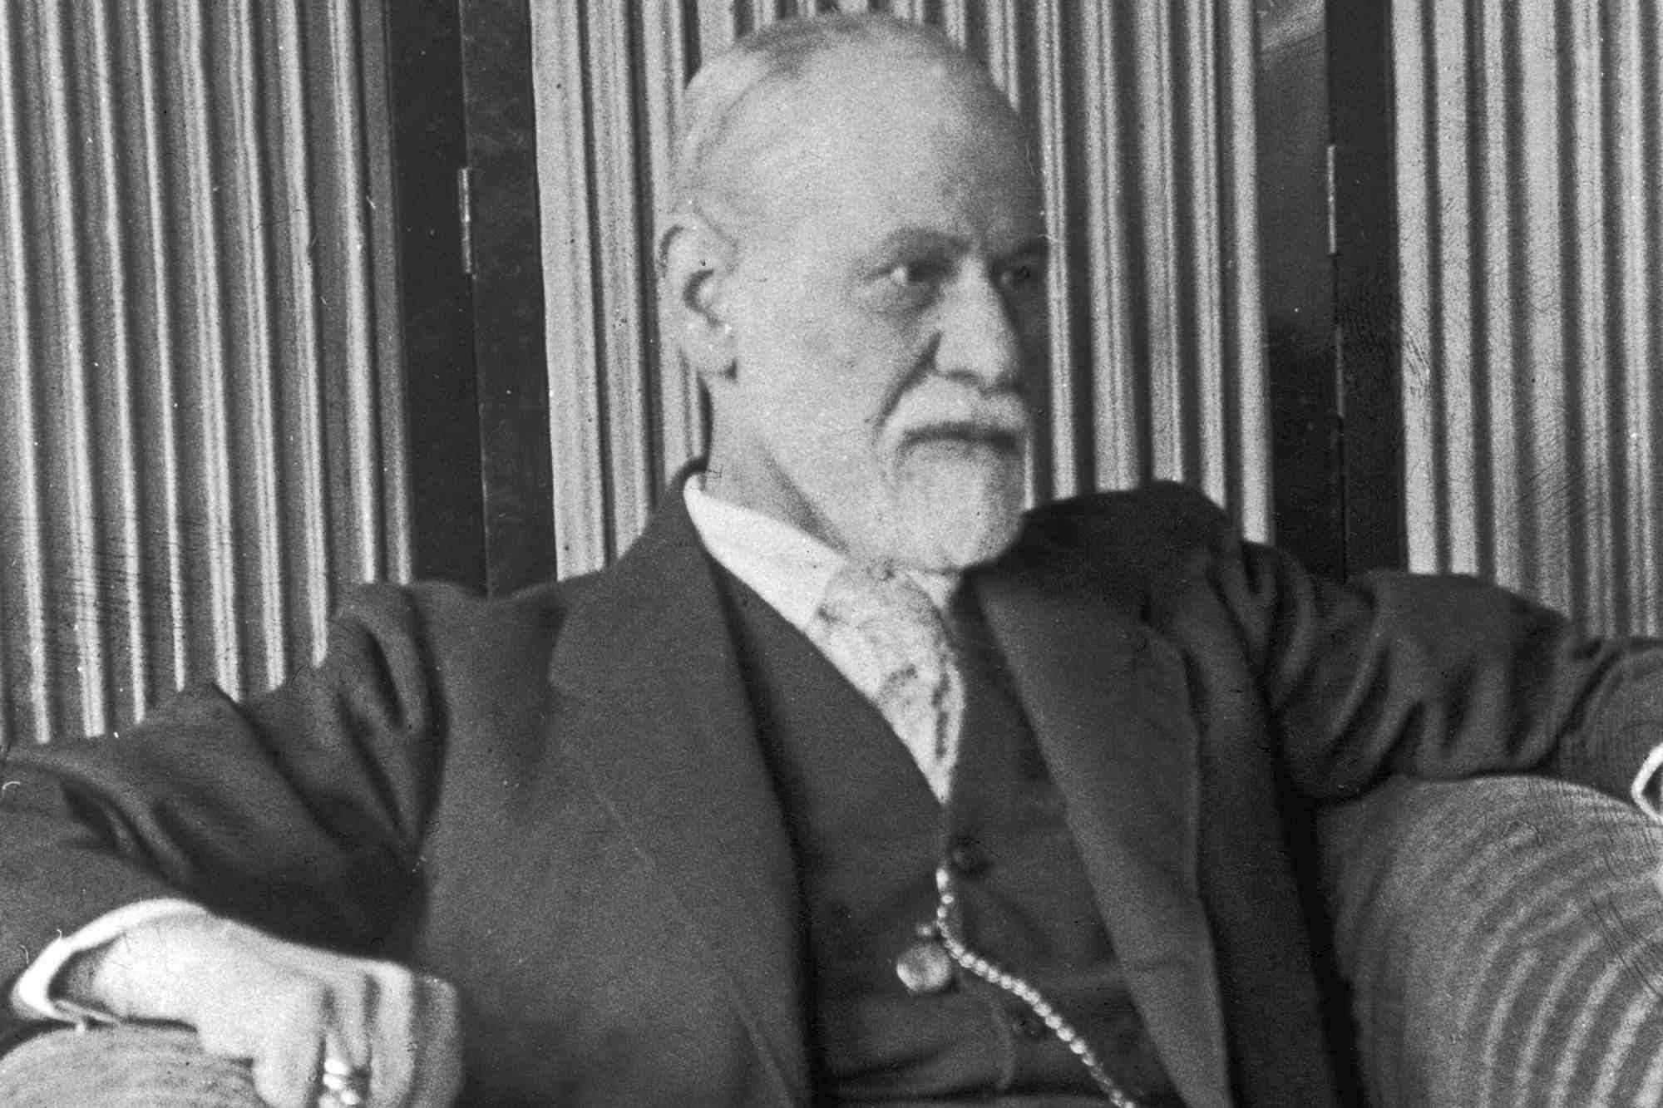
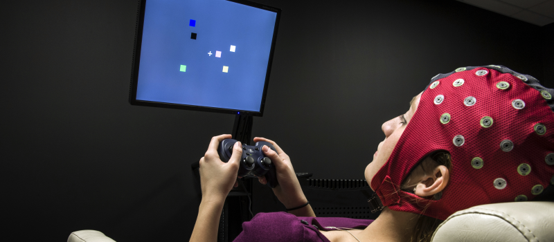
Psychology as a science
Psychology started in 19th century, focus on questions that philosophers spent 2,500 years on
So: out of the armchair, into the scientific method

Slide 4
Assumptions of quantitative research
Ontology (what exists?):
Things we want to study exist objectively
There is an objective truth about relationships
Those relationships are somewhat universal
→ Realism
Epistemology (how can we know?):
Can divide things into discrete categories, or describe them by small set of variables
Can get progressively closer to truth through the scientific method

Slide 5

So social science is about:
Unbiased systematic observation
Developing hypotheses and making progress through falsification
Generation of objective facts and general laws (‘human nature’)
Strive for causal explanation (thus need for control and experiments)

Slide 6
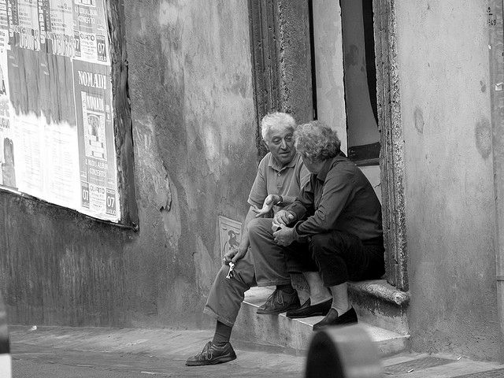
The qualitative critique

Slide 7
The qualitative critique
Is there really an objective reality where “prejudice” and “beauty” exist?
Or are we collectively creating these things through language? (Social constructionism)
Can we study individuals in an unbiased lab? Or are we always located in society?
Can there be a neutral observer? Or are there always power dynamics (race, gender, class, disability, sexuality …)?

Slide 8

What happens in a lab?
Unusual setting where individuals have a very special social role: “subject”
So schema is to be compliant and show no initiative
Notes:
“Subject” is the historical name – partly in response to the criticisms, we now have to say “participants”

Slide 9
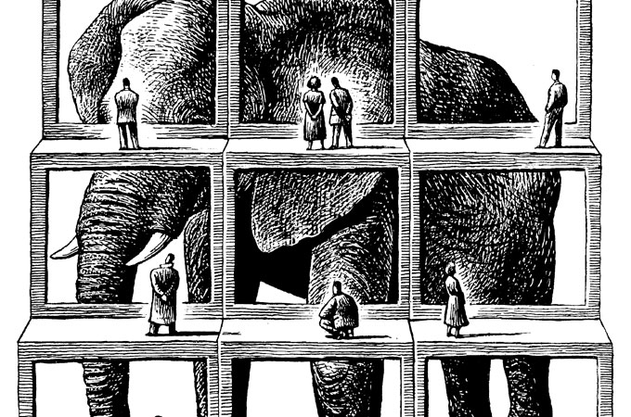
What happens in a lab?
Outside the lab, issues are always in a specific context
So what can lab experiments contribute to our understanding of real-life processes? (Ecological validity)
Notes:
“Subject” is the historical name – partly in response to the criticisms, we now have to say “participants”

Slide 10
Demand characteristics:
participants have expectations and/or read cues about what is expected, how they are supposed to act
Experimenter bias:
knowledge of the research hypothesis may subtly and unintentionally influence how participants are treated
→ Need for double-blind experiments where possible

Slide 11

Narrow participant pool (See: McVittie & McKinley, 2008)
Traditional psychological research often conducted on undergraduate psychology students
Easy access, financial reward, course credit
Notes:
Tend to be more educated, better cognitive skills, more compliant, narrow age range, wealthier.
https://slate.com/technology/2013/05/weird-psychology-social-science-researchers-rely-too-much-on-western-college-students.html

Slide 12
Narrow participant pool (See: McVittie & McKinley, 2008)
Why might that be a problem?
They (we) are from WEIRD backgrounds –majority-White, Educated, Industrialised, Rich and Democratic countries
And, not real adults (see Emerging Adulthood), in a setting that promotes compliance
Notes:
Tend to be more educated, better cognitive skills, more compliant, narrow age range, wealthier.
https://slate.com/technology/2013/05/weird-psychology-social-science-researchers-rely-too-much-on-western-college-students.html

Slide 13
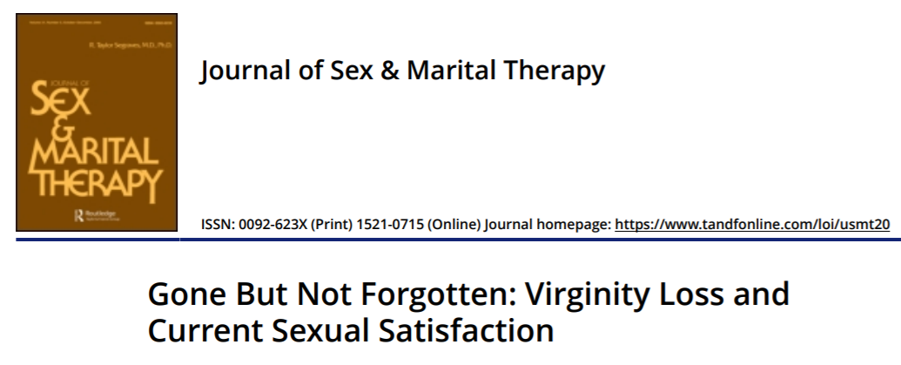
An extreme example

Slide 14
An extreme example
“These results suggest that one’s first-time sexual experience is more than just a milestone in development. Rather, it appears to have implications for their sexual well-being years later” (Abstract)
319 psychology students, mean age 18.9
Mean age of virginity loss: 16.7 years
Duration of study: 2 weeks
Participants filled in questionnaire about virginity loss at start
Participants to fill in a questionnaire after each “intimate interaction” rating 23 dimensions
Notes:
https://slate.com/human-interest/2013/01/virginity-loss-study-does-your-first-time-scar-you-for-life.html

Slide 15
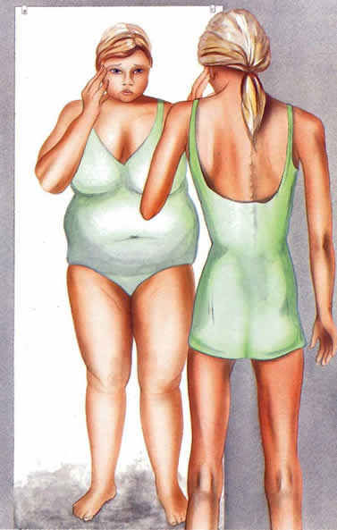
Criticism: Individualistic
Focus on individual as location of problem

Slide 16
Criticism: Individualistic
Focus on individual as location of problem
Goal of mainstream social psychology to fix the individual
e.g., fixing the personal psychology of anorexic girls
e.g., fixing the anxiety of individual students

Slide 17
So what’s the problem?
Individualism can encourage ‘victim blaming’
Critics would say: “We live in an oppressive and exploitative society – rather than challenge broad systems of social, cultural, economic and political inequality, psychology uses it knowledge to adapt people to its alienating conditions”
(read section about Marxism in Gough et al, 2013, ch.1)
Notes:
My research area – intergroup contact – has become more aware of that in recent years. “Let them eat harmony” – importance to both consider individual attitudes and systemic inequality

Slide 18
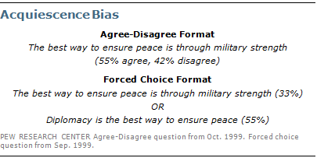
Criticism: Constraining choice
Quantitative measures force participants to select from a limited range of choices
Participants may never have considered phenomenon in numerical form, and answers are then easy to subtly influence / manipulate
Notes:
Might think the problem goes beyond this – maybe turning complex feelings into numbers just does not work

Slide 19
Criticism: Dehumanization
“Individuals become lost in the process of data collection… Numerical precision is achieved at the cost of meaningfulness” (Tuffin, 2005, p.47).
Summarising the victim of a rape or robbery as a statistic strips out the psychological significance and meaningfulness of the event (?)

Slide 20
An alternative view: Social Constructionism
Ontology: reality is socially constructed (goes against “realism)
“The way people think, the very categories and concepts that provide a framework for meaning for them are provided by the language they use” (Gough et al, 2013, p.14)
Language defines, produces or ‘constructs’ reality – more than one version of an event

Slide 21
The active role of language
Critique of mainstream view of language:
Language is not a transparent, passive, clear or pure medium through which our thoughts, feelings and internal states can be made available to others
Instead, language constructs reality, it does things, it has different effects and functions, it represents the world in particular ways.
Was Nelson Mandela a “freedom fighter” or a “terrorist”? [Short online lecture]
“Why are white people expats when the rest of us are immigrants?” [Guardian article]

Slide 22
Two ways of dealing with critiques
Become a critical social psychologist who
prioritises qualitative over quantitative data
prioritises advocacy over (“impossible”) neutrality as part of their research
(minority position in psychology)
Take them on board in mainstream social psychology
Consider social context of research
Consider role of language
Consider minority experiences
Be wary of WEIRDness in samples
Be respectful of participants and social impact of research

Slide 23
Some arguments to redeem quantitative social psychology
Has (relatively) clear standards to decide between competing theories
Ability to generate knowledge in cumulative process
Ability to decide empirically which findings are culturally specific and which are universal
Qualitative and subjective disciplines that focus on the role of social context exist – e.g., anthropology
Quantitative results are generally more likely to influence decision making

Slide 24
Time to collect your thoughts
Can you describe the difference between the worldviews underpinning quantitative and qualitative research?
Do you agree with any of the criticisms?
What questions do you have?

Slide 25
Lukas Wallrich (lukas.wallrich@ stmarys.ac.uk) October 2020 .
PSY4013 – Intro to Social Psychology
5: Challenges to Social Psychology
B: Replication crisis

Slide 26
Remember the aim
Quantitative (social) psychology aims to discover “universal” relationships
Should be able to predict what happens when we run an experiment again (accounting for variation due to chance)
Notes:
Many Lab 2 – published last year – had a success rate around 50% - with huge sample sizes

Slide 27
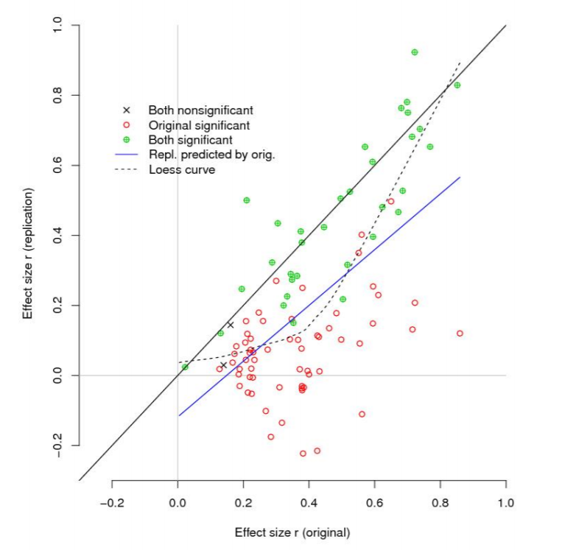
Replication crisis
“Reproducibility project” in 2015 replicated 100 studies
Notes:
Many Lab 2 – published last year – had a success rate around 50% - with huge sample sizes

Slide 28
Replication crisis
“Reproducibility project” in 2015 replicated 100 studies … only 36% again yielded significant results
Replicated effect sizes were half those of original studies
Worst in social psychology with ~25% replication
Many Labs 2 project in 2018 had 50% success rate – again with much reduced effect sizes
Notes:
Many Lab 2 – published last year – had a success rate around 50% - with huge sample sizes

Slide 29
Some well-known theories that are in doubt or debunked
Ego depletion / decision fatigue
Social priming (e.g., warmth of drink = warmth of person)
Marshmallow test
Stereotype threat?
Notes:
https://www.vox.com/science-and-health/2018/8/27/17761466/psychology-replication-crisis-nature-social-science
Also, any good theory is based on more than one experiment – e.g., ego depletion – so if one particular experiment does not replicate, just opens a need for discussion
Stereotype threat: I had shown you the results of a replication – now there is a new larger replication that shows no result:
https://www.tandfonline.com/doi/full/10.1080/23743603.2018.1559647
Good (though biased and slightly outdated) discussion of the situation with regard to stereotype threat: https://medium.com/@davenuss79/the-replicability-issue-and-stereotype-threat-research-a988d6f8b080

Slide 30
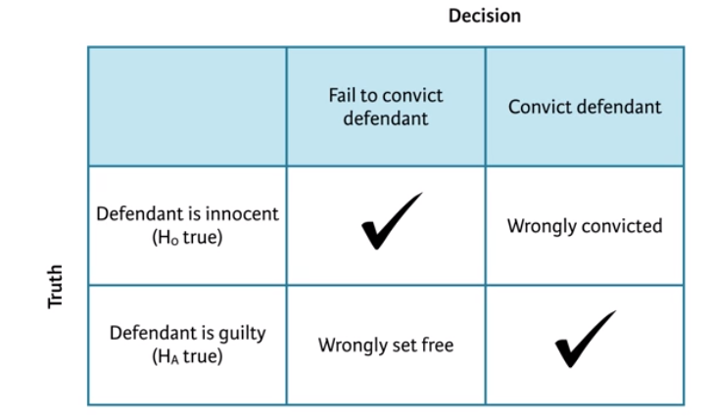
Insight from replications is limited
Any conclusion can describe reality correctly or incorrectly – in the legal system and in stats
Type I error
Type II error
In theory, we are more concerned about false positives than false negatives (# Type I errors < # Type II errors)
So should see somewhat more replications that wrongly fail to confirm findings than findings that are correctly debunked by a single replication → but, Many Labs 2 had huge sample sizes, thus low likelihood of Type II error

Slide 31
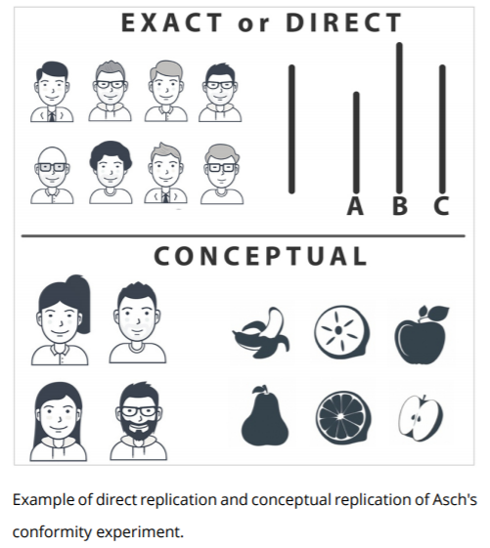
Types of replication
Direct: follows original protocol in as far as possible
Conceptual: tries to capture the idea in a different way

Slide 32
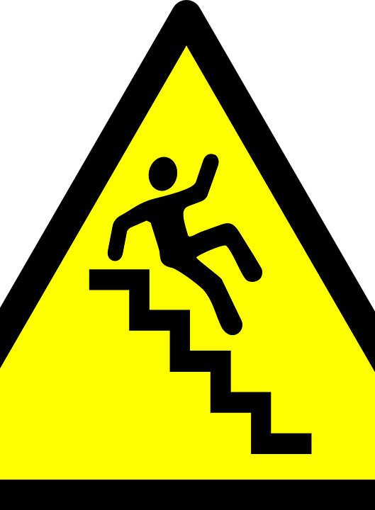
Why do we get so many false positives?
Fabrication (limited!)
Data analysis
Publishing bias
A problem with statistics

Slide 33
Problems with data analysis
Fabrication of results (e.g., Michael LaCour)
‘p-hacking’:
Slow: making analytical choices motivated by getting p below .05 (e.g., stopping data collection, excluding participants, removing outliers, transforming data, etc)
Fast: running lots of different comparisons (e.g., many different predictors, or outcomes, all tested separately)
HARKing: explore your data, look for patterns, and then test promising ones for significance (strict rule: should not look at your data before making decisions on statistical tests)
Garden of forking paths: need to legitimately make dozens of choices in data analysis – can subtly use each to move towards desired result
“If you torture your data long enough, they will confess to anything.” -Ronald Coase
Notes:
https://fivethirtyeight.com/features/science-isnt-broken
In published science, p-values just under .05 are over-represented – no reason why that should be
Problem with how we interpret the threshold – makes sense to have an agreed language, but that doesn’t imply that there is a real difference between p = .049 and p = .051

Slide 34
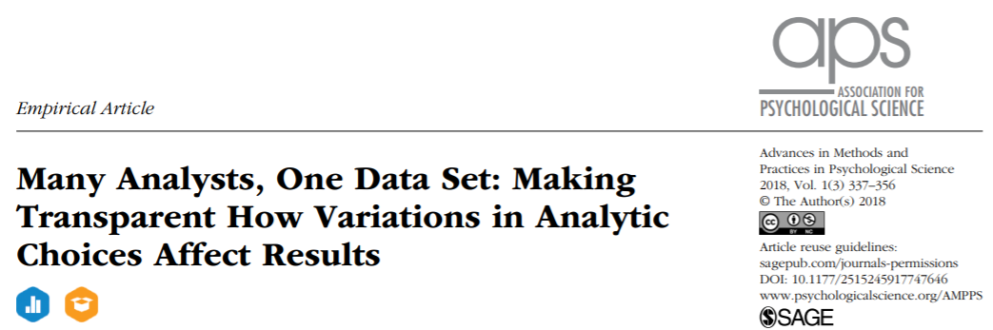
It is not just about (subtly) cheating with the data

Slide 35
Data analysis is a creative process
29 teams of statisticians analysed same dataset
Question: are soccer referees more likely to give red cards to dark-skinned than light-skinned players?
2/3 of teams found significant difference, 1/3 did not , large differences in effect sizes – and all used defensible methods
Usually, only few get done and one gets published – and it tends to favour the researcher
Notes:
Largest effect size: nearly 3x as likely.

Slide 36

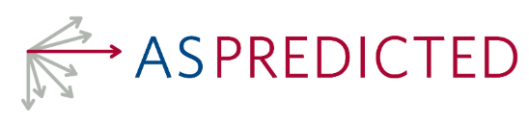
Importance of pre-registrations
Creates a public record before the start of data collection of all relevant analytical choices:
How much data will be collected?
How will the data be processed?
What specific statistical tests will be run?
Generally embargoed until publication, then visible
Prevents p-hacking and meandering in the garden of forking paths, unless people cheat

Slide 37
Reproducible research
Reproduction: independent researchers analyse the same dataset after publication
Movement argues that any reader should be able to reproduce analysis in an article, so publish
Traditional article
Data
Statistical analysis code
Any description needed to apply code to data
More advanced in many fields, e.g., Political Science, gaining momentum in psychology (challenge: use of SPSS)

Slide 38
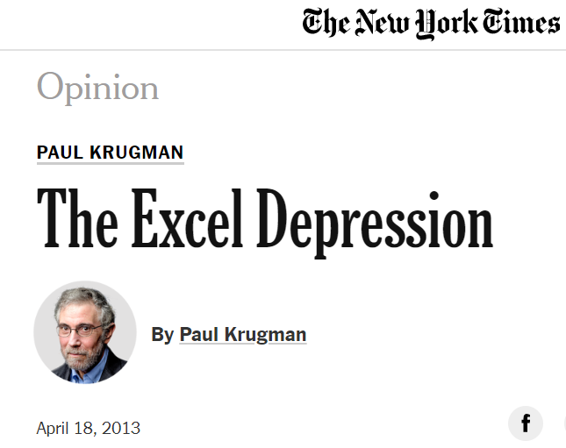
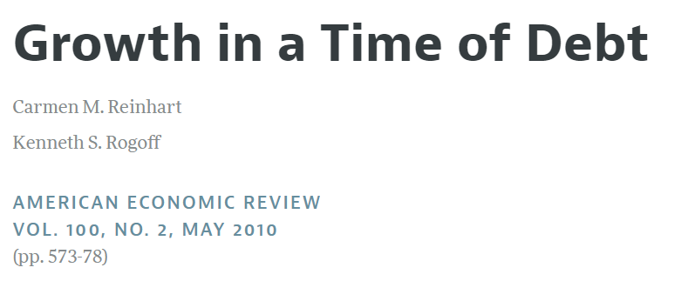
Key moment for reproducible research

Slide 39
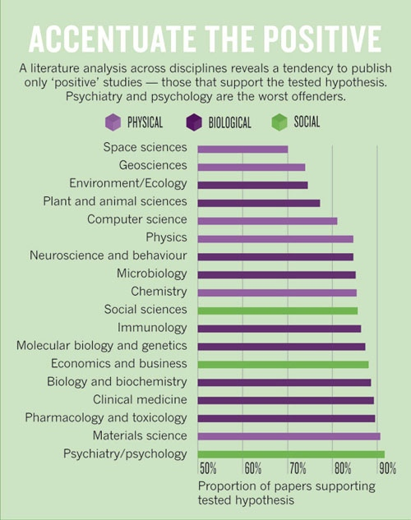
False positives due to publication bias
Notes:
Null results are important to know – especially when they contradict published positives, but also to avoid everyone going down the same wasted path
Opposite with replications
Small experiments with null results never get published – but small experiments in sexy field (social priming) will until a large replication attempt comes along

Slide 40
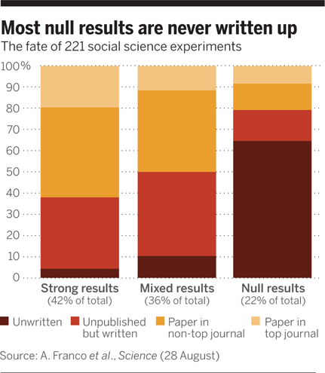
False positives due to publication bias
Notes:
Null results are important to know – especially when they contradict published positives, but also to avoid everyone going down the same wasted path
Opposite with replications
Small experiments with null results never get published – but small experiments in sexy field (social priming) will until a large replication attempt comes along

Slide 41
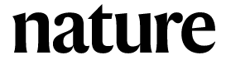
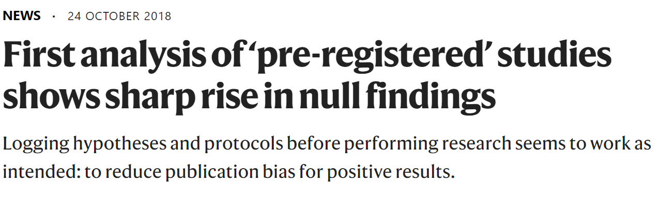

How to combat this?
If you read an experimental study that sounds interesting, you might want to have a look there

Slide 42
Two problems with standard statistics
Null-hypothesis significance testing mixes weakness of the study with absence of a difference
A small sample size with a large effect can have the same p-value as a large sample with small effect
So it is hard to assess what null findings are about
And:

Slide 43
Two problems with standard statistics
Null-hypothesis significance testing mixes weakness of the study with absence of a difference
A small sample size with a large effect can have the same p-value as a large sample with small effect
So it is hard to assess what null findings are about
And:
Does not consider prior probabilities, which we probably should for extremely unlikely hypotheses
Bayesian statistics helps with both issues – something for another course

Slide 44

What to do?
When you like an experiment, search for replications and meta-analyses
If there are none, treat it as an interesting idea
Don’t believe a theory that is based on a single experiment
Don’t treat a failed replication as a killer argument – good theories are build on more than one experiment
Notice when articles report that the analyses were preregistered – it should increase our confidence

Slide 45
Lukas Wallrich (lukas.wallrich@ stmarys.ac.uk) October 2020 .
PSY4013 – Intro to Social Psychology
5: Challenges to Social Psychology
C: Attitude- behaviour links

Slide 46
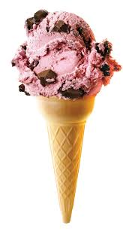
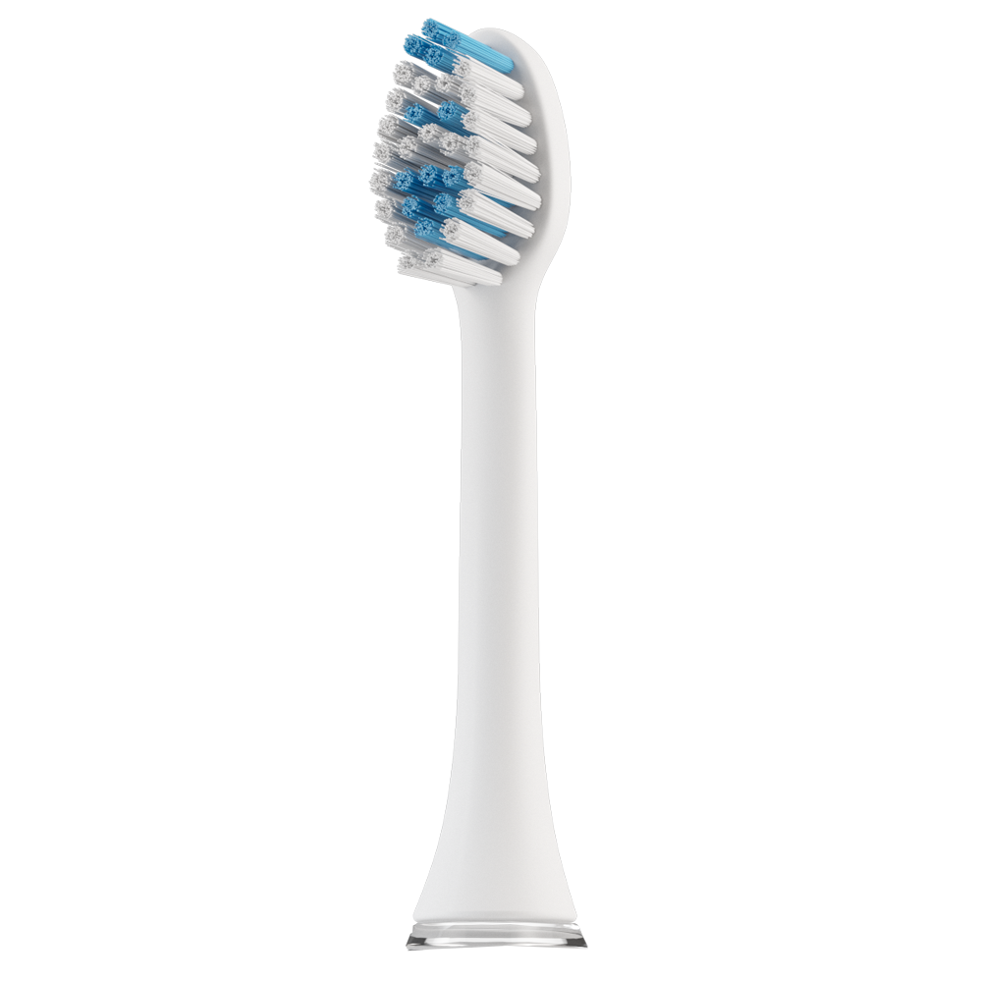
Studying attitudes
Social psychologists study attitudes towards …
Behaviours
Social groups
Environmental protection
Attitudes:
“Relatively enduring evaluation of an attitude object” (Albarracín et al., 2005)
Like / dislike / Love / hate
Cognitive and affective evaluation and behavioural intention
Notes:
Cognitive vs affective: Toothbrush vs chocolate ice cream
Often the study of “attitudes” creeps into behaviours and stereotypes without clear boundaries – here we only clearly need to distinguish attitudes from behaviours.
Good chapter to read: https://opentextbc.ca/socialpsychology/chapter/exploring-attitudes/

Slide 47

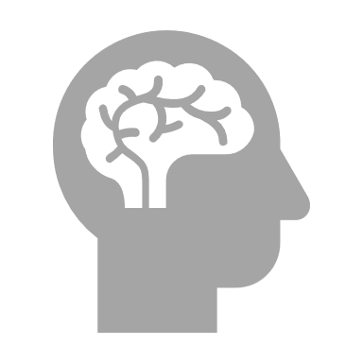
How to study attitudes?
Ask people (self-reports)
Social desirability
Self deception
Measuring vs creating
Observe
Arousal & facial expressions (Mendes, 2008)
Brain response, e.g., in scans (Cunningham, Raye, & Johnson, 2004)
Choices? (economists – revealed preferences)

Slide 48
How are attitudes formed?
Personal experiences
Conditioning
Interpretation of events (social cognition)
Explanation for our and others behaviour (attribution)
Social learning
Media
Groups
Genes (Bourgeois, 2002)
Likely those related to personality
Heritability above 50%: Abortion on demand, roller coaster rides and death penalty for murderers
Notes:
Good reading on heritability: https://apcentral.collegeboard.org/courses/ap-psychology/classroom-resources/understanding-heritability
50% is similar to heritability of Big Five personality traits

Slide 49
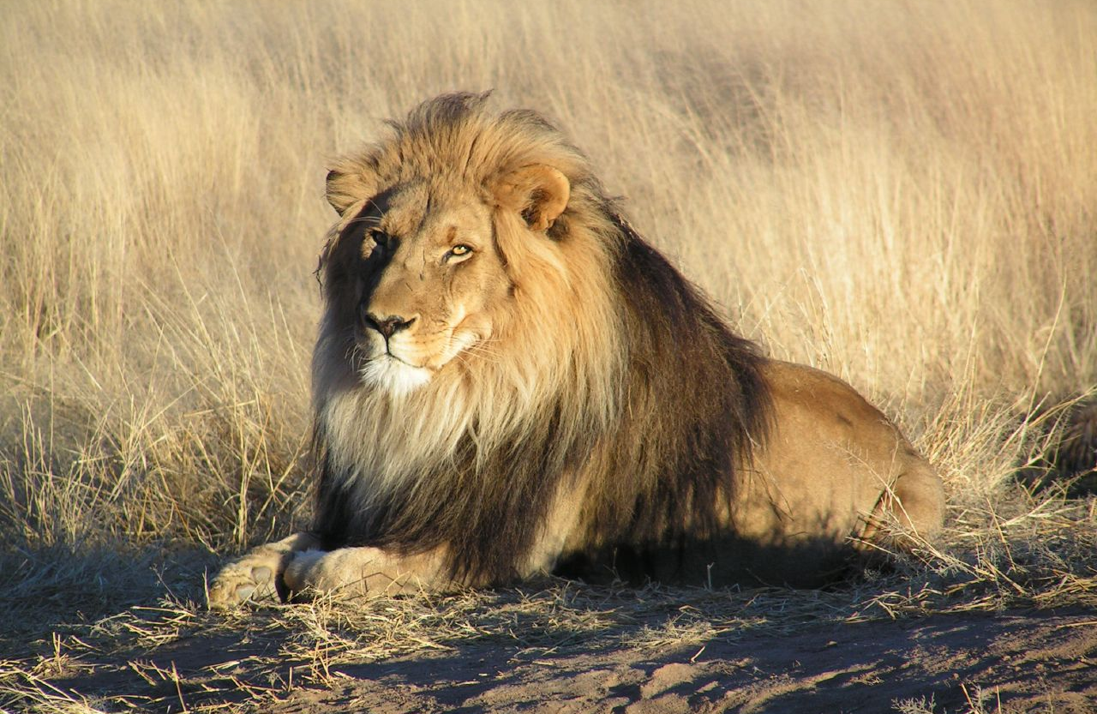
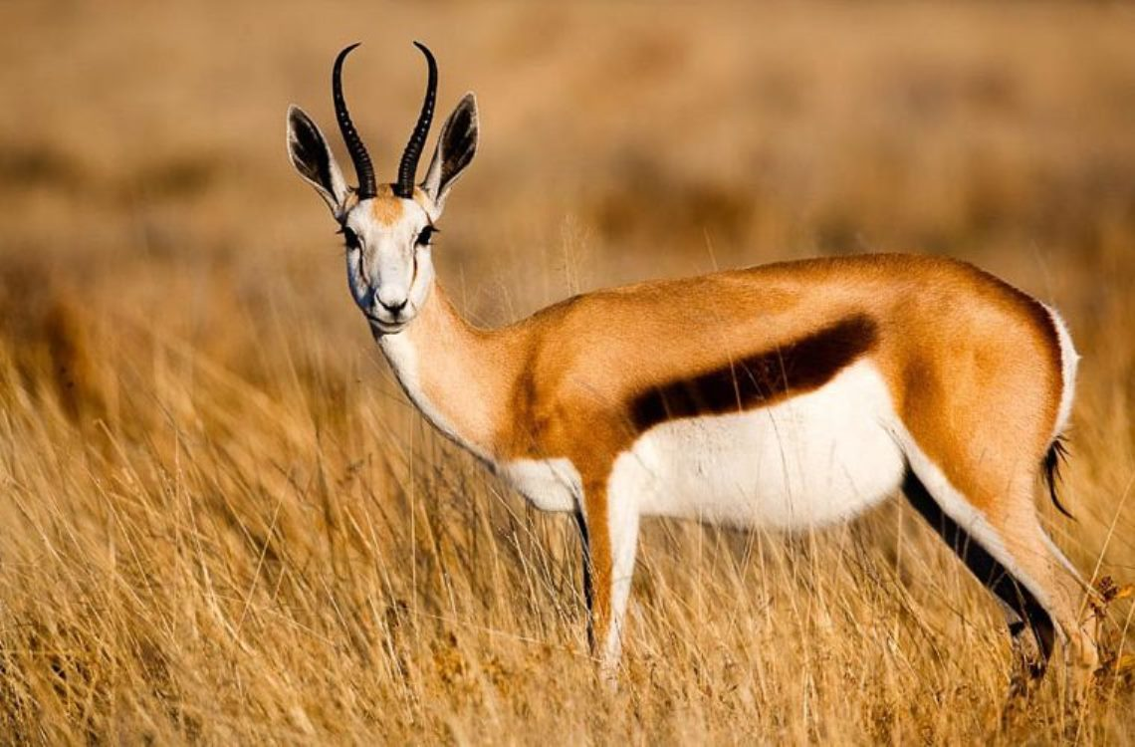
Attitudes predict behaviour
… but it’s complicated!

Slide 50
Attitudes predict behaviour
Evolutionary shortcut to decision making:
Lion = bad -> run away
Antelope = good food -> hunt
In general, observe relationship between affect, cognition and behaviour
meta-analysis: Glasman & Albarracín, 2006
Pearson’s r = .51
R² = .25
Only with specific attitudes, high variability
Kraus (1995) incl. more general attitudes: avg. r = .38
So: when are attitudes and behaviours linked?
What is the direction of the relationship?
Notes:
Kraus: very small relationships with more general links: attitude towards religion and church attendance

Slide 51
Strong Attitude-Behaviour Relationships
Attitudes linked to a specific behaviour (Ajzen & Fishbein, 2005)
Attitudes accessible
Direct experience
Frequently reported
Attitudes stable over time (Glasman & Albarracin, 2006)
Attitudes salient in the situation (Snyder & Swann, 1976) and other influences are minimised (Kraus, 1995)

Slide 52
Snyder & Swann, 1976: sex discrimination
120 male undergraduates wrote an opinion essay on a court case about hiring a woman – 2x2 conditions:
disagreeing partner
attitude salience
Wrote essay expressing their opinion. Scored from 1: against plaintiff to 10: for plaintiff

Slide 53
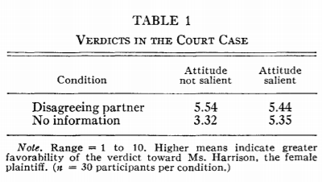
Snyder & Swann, 1976: sex discrimination
Wrote essay expressing their opinion. Scored from 1: against plaintiff to 10: for plaintiff
Notes:
Own attitude now correlated with .6 correlation coefficient

Slide 54
Behaviour-Attitude Relationship
So attitudes often lead to behaviours.
But do behaviours lead to attitudes?
“Thought is the child of Action.”
(Disraeli, 1826)

Slide 55
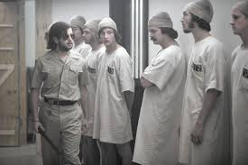

Attitude-Behaviour Relationship
Role Playing: The “roles” we play can influence how we think and feel (attitude).
The Stanford Prison Experiment
(Zimbardo, 1971)
“By acting like a man in love, he became a man in love again”

Slide 56
Attitude-Behaviour Relationship
Apart from social roles, why does behaviour influence attitudes?
Self-Perception Theory
Self-Presentation Theory
Cognitive Dissonance Theory

Slide 57
Self-perception
We find out how we feel by observing what we do.
We are likely to infer our feelings from our behaviour when our initial feelings are weak or unclear.
E.g., facial expressions as a cue to emotions (Larsen, Kasimatis, & Frey, 1992), even on avatar in virtual reality setting (Ma et al., 2016)
We use our behaviour to tell us about ourselves when we believe that we freely chose the behaviour.
E.g., smiling does not increase happiness if we are told to smile for that purpose (Labroo et al., 2014)

Slide 58
Self-presentation
We attempt to present who we are, or who we want people to believe we are.
We then internalise these presentations (self-perception strengthened – “the looking glass self is also a magnifying glass”, Tice, 1992)

Slide 59
Cognitive Dissonance
Inconsistency between two thoughts.
Can also be the result of inconsistency between attitude and behaviour
Uncomfortable, so
What happens when you lie about how much you enjoyed something?
If there is no other motivation (e.g., payment), attitudes are changed to match behaviour (Carlsberg & Festinger, 1959, and Harmon-Jones & Harmon-Jones, 2007)
Also, doubts are reduced after decision (e.g., after bet or vote)
Notes:
How do we tell the difference between self-perception and cognitive dissonance? They often make the same predictions – so still a live area of debate how they are related.

Slide 60
What about attitude change?
“Any considerable modification of an individual’s attitude, the process of which involves several variables; it can also come about by getting a person to engage in a behaviour associated with a particularly attitude.”
(Hogg & Vaughan, 2005)
When only attitudes are targeted, attitude-behaviour gap can open up.
Students’ intentions to recycle 2x the actual recycling rate (Chung & Leung, 2007)

Slide 61
Conflicting norms?
LaPiere’s 1934 article “Attitudes vs Actions”
Visited 251 hotels and restaurants in US with Chinese couple – turned away once
Then surveyed the establishments (and others) – over 90% said they would not accept Chinese customers
Why?

Slide 62
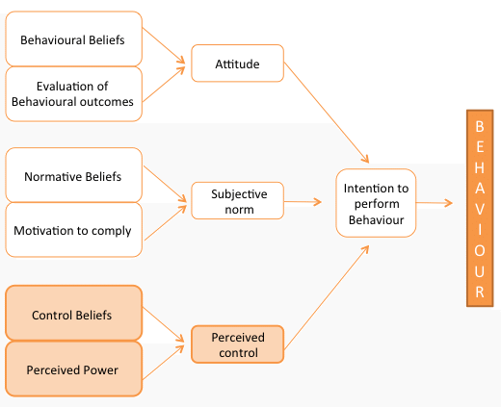
Moving from intention to action: Theory of Reasoned Action (Fishbein & Ajzen, 1967)

Slide 63
Moving from intention to action: Theory of Planned Behavior (Ajzen, 1985)
Notes:
Recent addition (https://onlinelibrary.wiley.com/doi/abs/10.1348/014466604X17452): should also consider “moral norms” we hold for ourselves as they can be stronger than other people’s norms

Slide 64
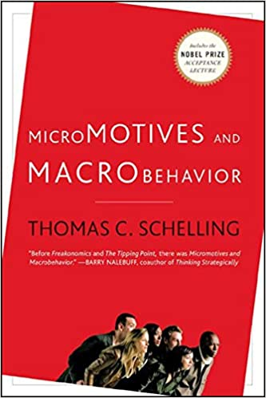
Predicting aggregate behaviours
Notes:
Sometimes just a matter of thinking about where attitudes lead – if group A (majority) only wants to live in areas where they make up three quarters, and group B (minority) only wants to live in areas where they make up at least 1/3, what is the only stable result? But even compatible preferences with small reference group lead can lead to very high level of segregation (cafeteria effect)

Slide 65
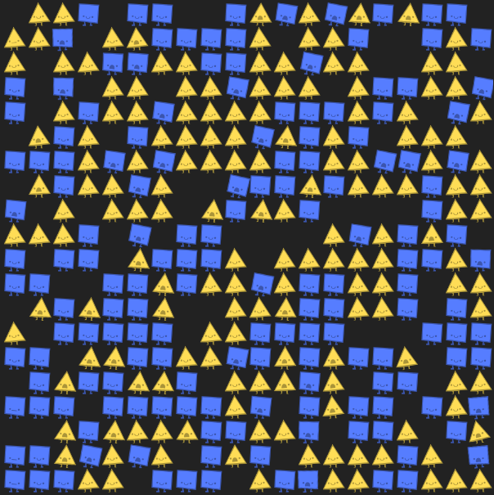
“A dynamic model of segregation”
Notes:
https://theconversation.com/this-simple-experiment-shows-how-easy-it-is-for-society-to-become-segregated-55593

Slide 66
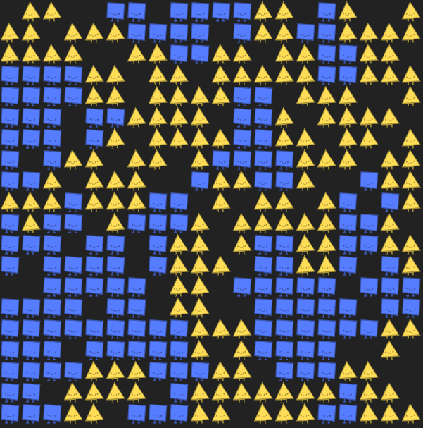
Small bias leads to large segregation

Slide 67
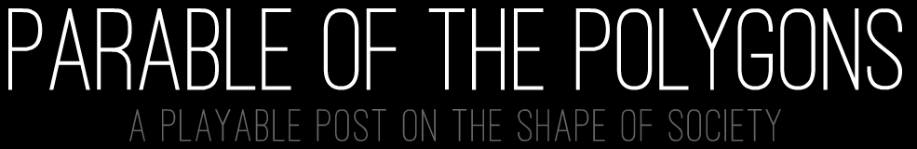
Agent-based modelling
Approach that is gaining popularity in psychology
Computer simulation of behaviours based on simple rules (attitudes)
Allows to test whether explanations/theories of macro-behaviour actually work

Slide 68
Behaviour & Attitude: What to know?
Understand what an ‘Attitude’ is
Relationship between behaviours & attitudes
When Attitude – predicts → Behaviour
When Behaviour – predicts → Attitude
Theory of Planned Behaviour
Link between attitudes and macro-behaviours not always obvious – critical thinking & modelling
How is this related to previous sections of the module? E.g.,
I didn’t act in accordance to my attitude because I didn’t see the situation in that way. (Social Cognition)
I thought my attitude was different from what my group wanted me to do (Conformity / compliance)
I liked a certain way of acting, so I came to adjust my attitude (motivated reasoning/cognitive dissonance)

